Slide 1
Snow board
PREPARED BY:B.SWATHI
J.SWETHA

Slide 2
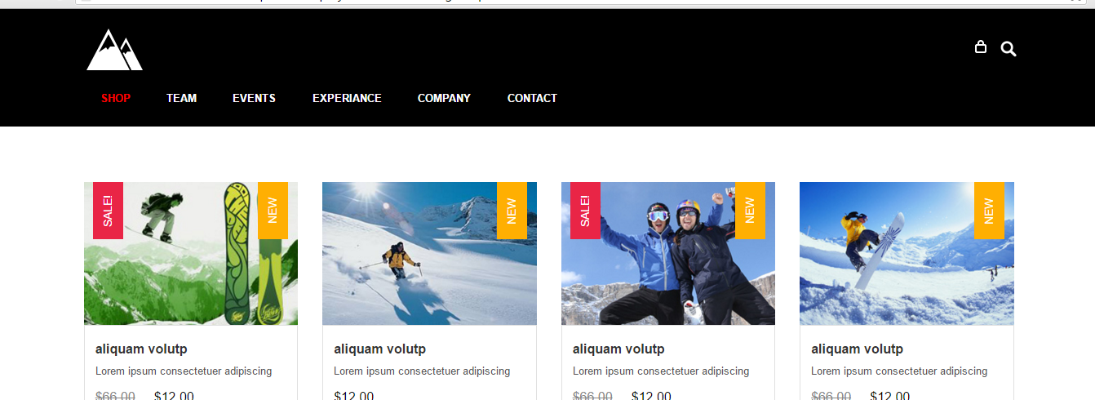
You will select what you want

Slide 3
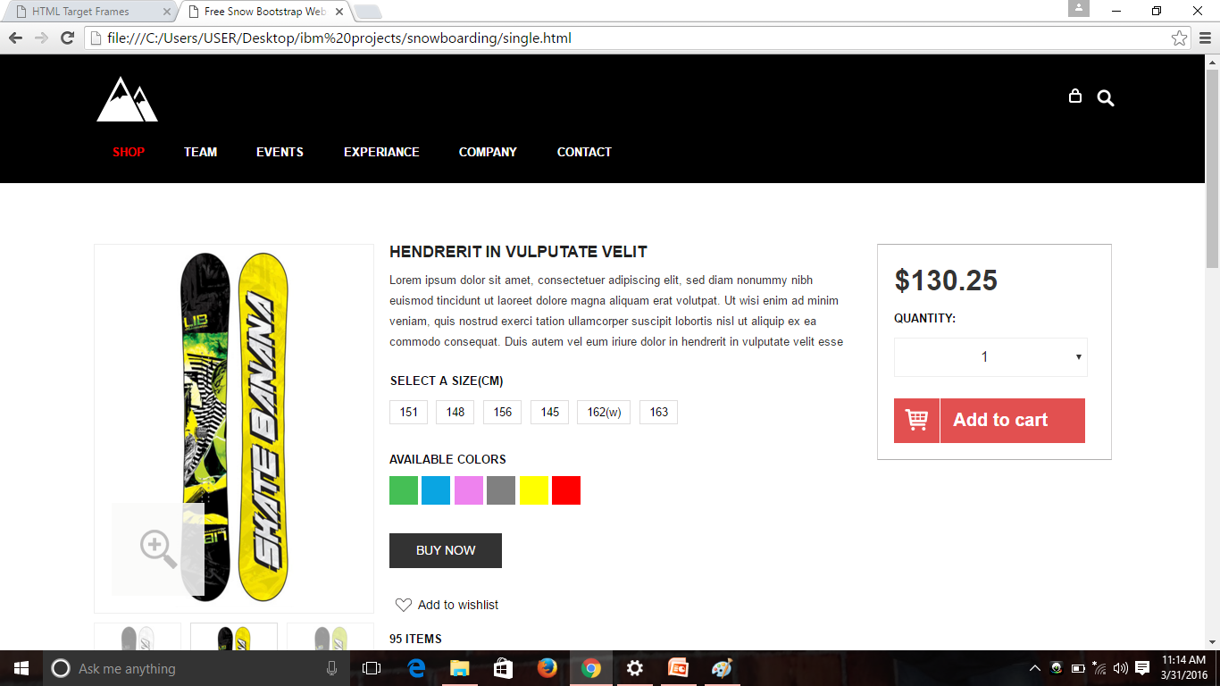
it will show the site buy it.

